Slide 1
Leetcode Workshop
Session 1 - Intro + HashTables

Slide 2
Agenda
Introduction
Housekeeping
Pair Programming
Leetcode IDE
Warmup - Single Number
Hash Tables
Hash Table Practice Questions

Slide 3

About Me
Year 3 Math Major, but also interested to be a Software Engineer
Experience in Software Engineering and Preparing for Technical Interviews
Stack:
React (Front-End)
Cypress (e2e testing)
Kotlin Spring (Back-End)
Notable project: kzhaoyuan.com
Fun fact: Self-learned Japanese to N2 During National Service

Slide 4
Self-Introductions
You’ll be working with each other often!

Slide 5
Housekeeping

Slide 6
Housekeeping
Fork https://github.com/virtuoso98/leetcode_workshop for resources, code and schedule
Telegram Group for Info dissemination
Please pay $15 deposit by PayLah or PayNow. Will be returned upon end of workshop, provided at least 5/7 sessions attended
Location, Hours: TBC

Slide 7
Why Pair Programming?

Slide 8
Pair Programming
Pair programming - Working in pairs to solve problems (loosely)
Tech firms are not just looking for good coders, but coders who can communicate their solutions
Working in Tech is not a silo job, but a team effort
Please work with different people each week!

Slide 9
Leetcode IDE
Simple and easy to navigate
Clean, no frills answering format
Curated questions from top companies
A short tour of the Leetcode IDE (Please create an account!)

Slide 10
Programming Warmup
Contains Duplicate - https://leetcode.com/problems/contains-duplicate/

Slide 11
This is a very trivial LeetCode Question, but how did you solve it?

Slide 12
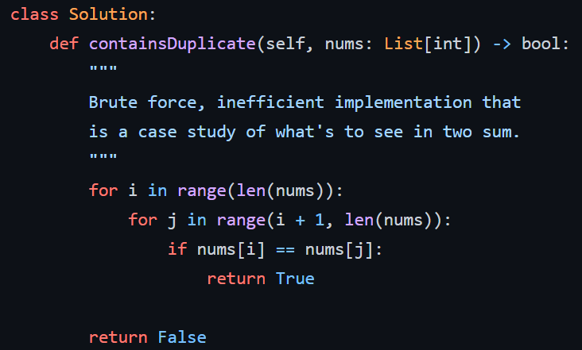
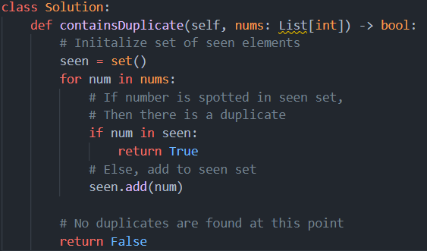
Compare these 2 valid solutions...

Slide 13
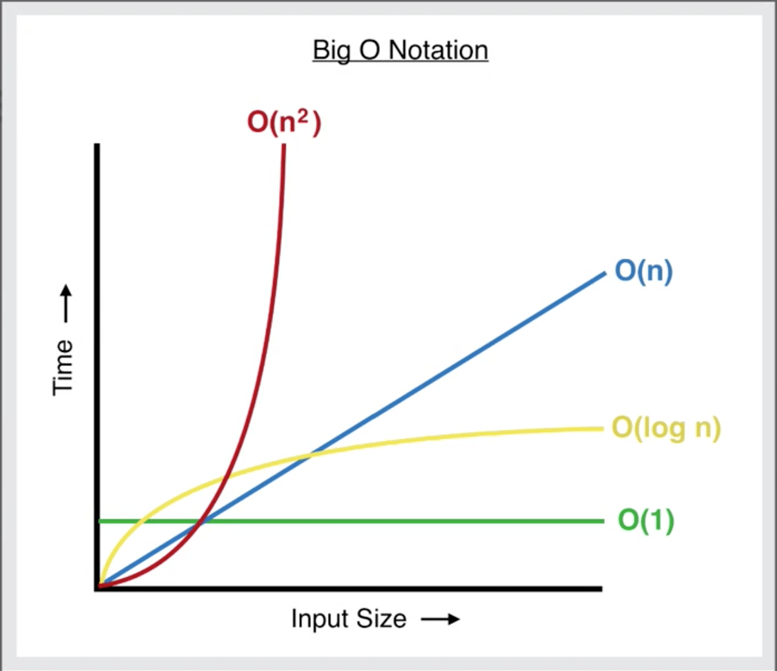
Runtime Complexity
Focus on runtime - Big-O
Loosely, how does program runtime scale relative to data size?
To excel, code needs to be efficient
In general, think about brute force solution first, then efficient solution

Slide 14
Food for Thought
What broad technique am I using to solve the problem?
High-level approach to algorithm
Any edge cases I need to account for?
Coding out the actual approach

Slide 15
Hash Tables/ Sets
A perfect way to remember data that you’ve previously seen

Slide 16
Hash Tables
Hashing - Deterministic conversion of value to a unique key, or index in a Hash Table
Hash Table - Data structure that stores data in an associative manner (key-value) pair in a large
Pros:
O(1) Lookup Time (Keys), O(1) Insertion, O(1) Removal
Cons:
O(n) Lookup Time (Values)
More in-depth explanation in YSC2229 DSA, not here!

Slide 17
Hash Sets
Very similar to what you learnt in Mathematics
Highly optimized for lookup-time
Stores a collection of values as opposed to Key-Value relationships
Pros:
O(1) Lookup Time, O(1) Insertion, O(1) Removal
Cons:
Values are not stored in any particular order
Only instances of immutable types can be added

Slide 18
Programming Warmup
Majority Element- https://leetcode.com/problems/majority-element/

Slide 19
Hints
Think about how to avoid a KeyError which often appears!
Do not hesitate on how to search Google for this very useful snippet (but NOT the solution)
Otherwise, Algorithm is very straightforward

Slide 20
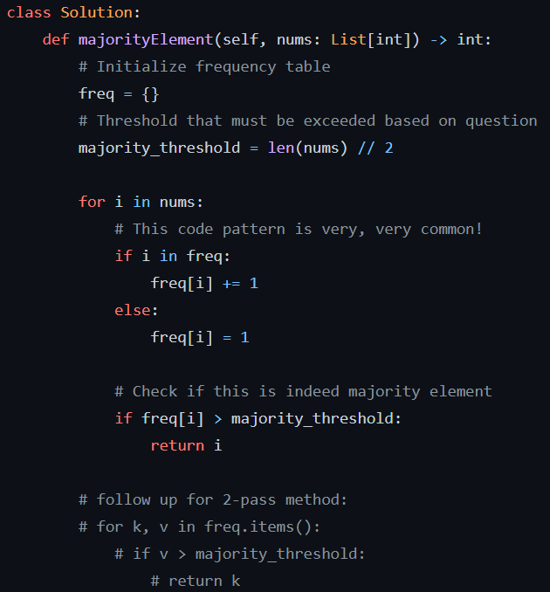
Solution
Broad approach:
Initialize freq table and majority threshold
Populate freq table then check if it exceeds threshold (to do it in 1-pass)

Slide 21
Programming Warmup
2 Sum - https://leetcode.com/problems/two-sum/

Slide 22
Hints
Think briefly about the brute-force implementation and see how that is inefficient.
Consider the Relationship between key-value pairs in the dictionary.
Remember the return type! This is something you must be very sensitive to.

Slide 23
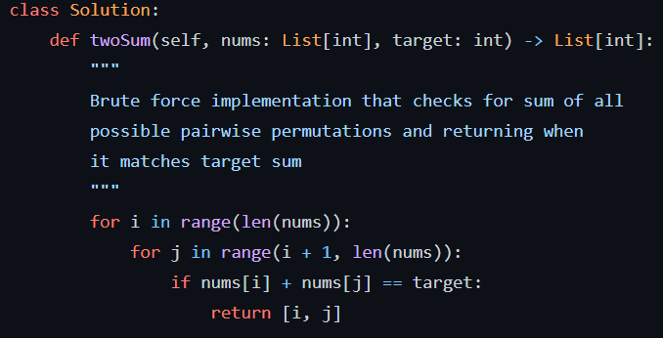
Solution - Brute

Slide 24
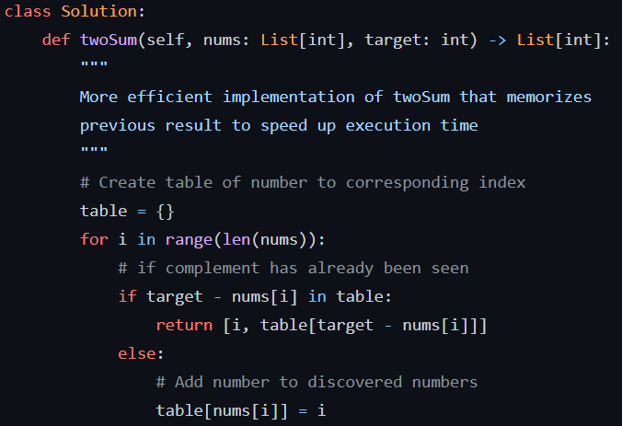
Solution - Hash

Slide 25
Extension
3 Sum - https://leetcode.com/problems/3sum

Slide 26
Hints
There are Multiple requirements to this question. Think about how to tackle them one-by-one!
Consider using Python’s built-in sorting function. They usually run at O(n log(n)) complexity so if your final algorithm is running at O(n log(n)) or slower, sorting has a positive effect.
Can you apply 2Sum to 3Sum? If you fix one element, then…?
After sorting the function, consider how you’d avoid repetition of triplets after finding one

Slide 27
Intuition
Sort the Array in ascending order
Fix a pointer to the lowest value and For-loop
If Lowest value is positive, break from the loop because sum must be positive
Perform 2Sum to the right of the pointer
Once found, append answer and prevent repetition by shifting pointer to prevent repetition
Return Answer

Slide 28
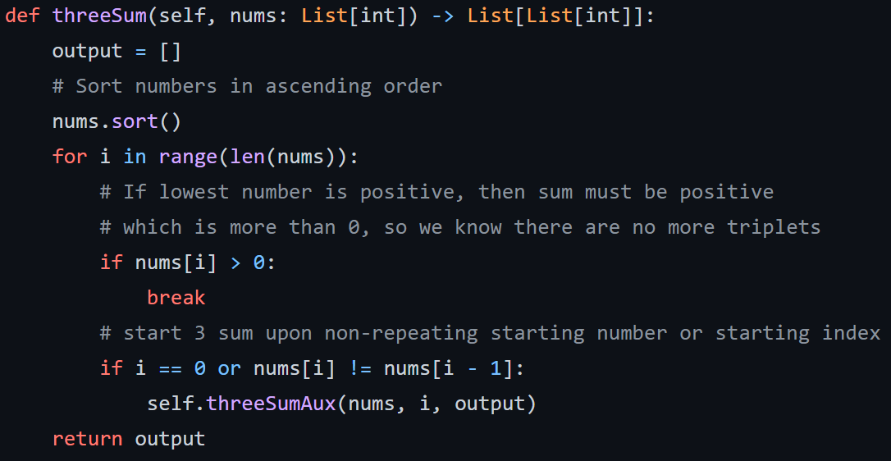
Solution - Main

Slide 29
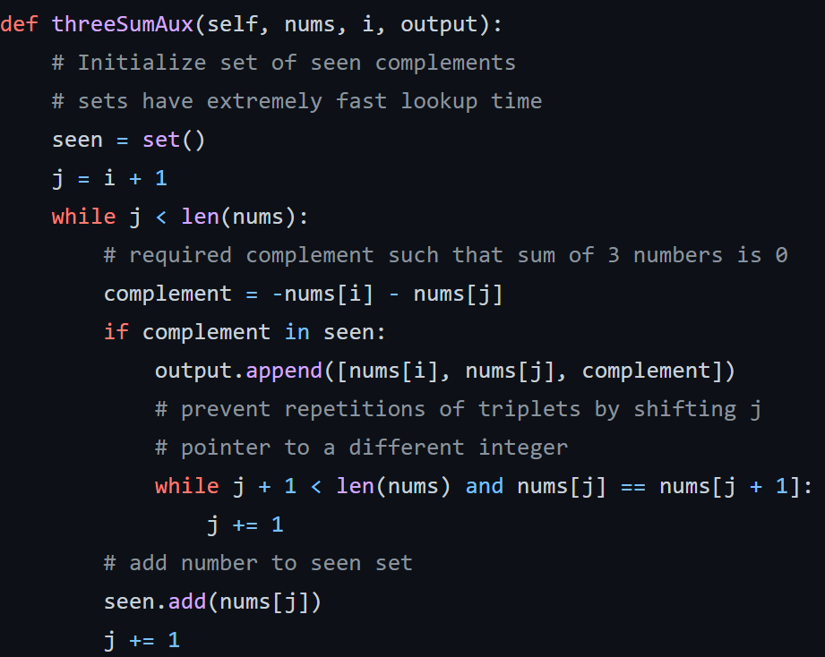
Solution - Helper

Slide 30
Thank you!
See you next week.

